Slide 1
Synchronization
(Application of Semaphore)

Slide 2
Bounded Buffer Problem
Producer and Consumer share a fixed size buffer used as a queue
Producer generates piece of data and put it into the buffer and start again
Consumer removes data from the buffer
Concern 1: Producer won’t produce data when the buffer is full
Concern 2: Consumer won’t remove data when the buffer is empty

Slide 3
Inadequate Solution
procedure producer(){
while(true){
item = produceItem();
if(itemCount == BufferSize)
Sleep();
putIntoBuffer(item);
itemCount ++;
if(itemCount == 1)
wakeup(consumer);
}
}
procedure consumer(){
while(true){
if(itemCount == 0)
Sleep();
item = removeFromBuffer();
itemCount --;
if(itemCount == BufferSize - 1)
wakeup(producer);
}
}
DEADLOCK !!!
If, consumer is interrupted just after checking the itemCount value and before sleep() call, and producer produces an item it will call wakeup(). But, this call will be lost as no consumer in sleeping yet. And it will continue to produce items. Eventually, producer will sleep when the buffer is full. On the other hand, consumer will also stay in sleep as producer won’t call wakeup().

Slide 4
Use of Semaphore for Solution
Solves the lost wakeup call by using two semaphore - countFill, countEmpty
countFill: number of available item in the buffer to be read
countEmpty: number of available space in the buffer to write
If producer tries to decrement countEmpty when it is 0, will be put to sleep
When an item is consumed, countEmpty will be incremented and producer wakes up.

Slide 5
Semaphore for multiple producer consumer
semaphore mutex = 1;
semaphore countFull = 0;
semaphore countEmpty = BUFFER_SIZE;
procedure producer(){
while(true){
item = producedItem();
wait(countEmpty);
wait(mutex);
putIntoBuffer(item);
signal(mutex);
signal(countFull);
}
}
procedure consumer(){
while(true){
wait(countFull);
wait(mutex);
item = removeFromBuffer();
signal(mutex);
signal(countEmpty);
consumeItem(item);
}
}

Slide 6
Reader - Writer Problem
Data is shared among number of processes
Any number of readers may simultaneously read the data
Only one writer can write to the data at a certain time
If a writer is writing, no reader can read
If at least one reader is reading, no writer can start writing
Readers only read, Writers only write

Slide 7
Variation
First reader-writer problem: No reader will be kept waiting, unless a writer has got the permission to use the data, i.e., no reader should wait for other reader to finish
Second reader-writer problem: Once a writer is ready, the writer performs as soon as possible, i.e. no new readers can start reading.
Solution to either problem may create starvation.
First case: writer may starve
Second case: reader may starve

Slide 8
Solution to First Variation (1)
Reader process has the following data structures -
semaphore rw_mutex = 1;
semaphore mutex = 1;
int read count = 0;
rw_mutex: common to both reader and writer, functions as mutual exclusion semaphore for writer
mutex: ensures mutual exclusion when read_count is updated
read_count: keeps track of how many processes are reading the object

Slide 9
Solution to First Variation (2)
writer process has the following code skeleton -
do{
wait(rw_mutex);
/* writing is performed */
signal(rw_mutex);
} while(true);
If a writer is in the critical section and n readers are waiting
One reader is queued on rw_mutex
Other n-1 readers are queued on mutex
When a writer executes signal(rw_mutex)
Resume the execution of either waiting readers or single waiting writer

Slide 10
Solution to First Variation (3)
reader process has the following code skeleton -
do{
wait(mutex);
read_count++;
if(read_count == 1)
wait(rw_mutex);
signal(mutex);
/* reading is performed */
wait(mutex);
read_count--;
if(read_count == 0)
signal(rw_mutex);
signal(mutex)
} while(true);
If a process wish to read, it requests rw_mutex in read mode
If a process wish to write, it requests rw_mutex in write mode
Multiple process can acquire rw_mutex in read mode
Only one process can acquire rw_mutex in write mode

Slide 11



Reader-Writer Solution
rw_mutex | -1
mutex | -1
read_count | 2
rw_mutex | 0
mutex | 1
read_count | 0
rw_mutex | -1
mutex | 0
read_count | 1
rw_mutex | 1
mutex | 1
read_count | 0

Slide 12
Reader-Writer Solution
rw_mutex | 0
mutex | -1
read_count | 2
rw_mutex | 0
mutex | 0
read_count | 2
rw_mutex | -1
mutex | -1
read_count | 2
rw_mutex | 1
mutex | 1
read_count | 0
rw_mutex | 0
mutex | 1
read_count | 2

Slide 13
Reader-Writer Solution
rw_mutex | 1
mutex | 1
read_count | 0
rw_mutex | 0
mutex | 1
read_count | 1
rw_mutex | 0
mutex | 0
read_count | 0
rw_mutex | 0
mutex | -1
read_count | 1
rw_mutex | 0
mutex | 0
read_count | 1
rw_mutex | 0
mutex | 0
read_count | 1
rw_mutex | 0
mutex | 1
read_count | 0
rw_mutex | 1
mutex | 1
read_count | 0
rw_mutex | 0
mutex | 1
read_count | 2
rw_mutex | 0
mutex | 0
read_count | 2
Hurraaaah !
I got permission for writing :D
I want to write…
But, rw_mutex is not allowing me :’(

Slide 14
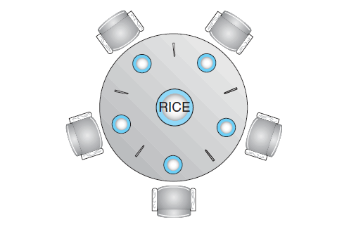
Dining-Philosophers Problem
In the center of the table is a bowl of rice, and the table is laid with five single chopsticks
From time to time, a philosopher gets hungry and tries to pick up the two chopsticks that are closest to her
When a hungry philosopher has both her chopsticks at the same time, she eats without releasing the chopsticks
When she is finished eating, she puts down both chopsticks and starts thinking again

Slide 15
Solution to the problem
One of the simple solution is to use 5 semaphores for 5 chopsticks.
semaphore chopstick[5];
Structure of i^{th} philosopher’s process can be -
do{
wait(chopstick[i]);
wait(chopstick[(i+1)%5]);
/* Eat for a while */
signal(chopstick[i]);
signal(chopstick[(i+1)%5]);
/* Think for a while */
) while(true);

Slide 16

BUT GUESS WHAT’S COMING????
If all the philosophers are hungry at the same time and grab their left chopstick by calling wait(chopstick[i]), No one will ever find a second chopstick for eating. Consequently, they will die from starvation :P

Slide 17

How to prevent deadlock in this solution?

Slide 18
How to prevent deadlock in this solution?
Allow at most four philosophers to be sitting simultaneously at the table
Allow a philosopher to pick up her chopsticks only if both chopsticks are available (to do this, she must pick them up in a critical section).
Use an asymmetric solution — that is, an odd-numbered philosopher picks up first her left chopstick and then her right chopstick, whereas an even-numbered philosopher picks up her right chopstick and then her left chopstick.

Slide 19
Necessary Conditions for Deadlock
Necessary conditions for deadlocks are -
Mutual Exclusion
Hold and Wait
No Preemption (cannot force to release the resource)
Circular wait
If one of these are not present in a system, then the system is “Deadlock Free”.

Slide 20
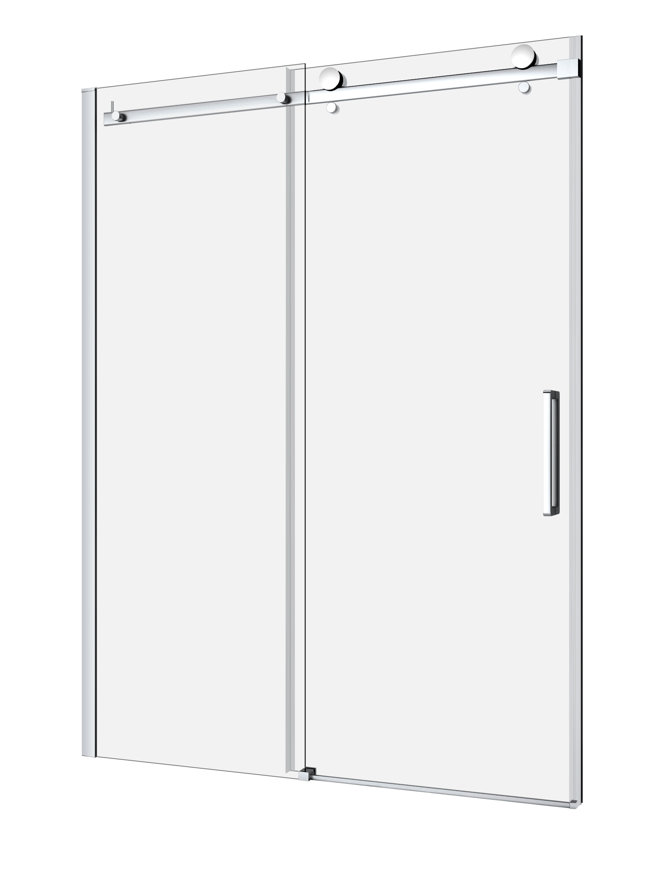




The Sleeping Barber Shop
If there is no customer, the barber sleeps in the barber chair.
When a customer arrives, he has to wake up the barber.
If there are many customers and the barber is cutting a customer’s hair, then the remaining customers either wait if there are empty chairs in the waiting room or they leave if no chairs are empty.

